Slide 1

POWER BI PROJECT
PROJECT TITLE : E COMMERCE SALES & PROFIT PERFORMANCE ANALYSIS

Slide 2
PROJECT AGENDA
Project Objective
Data Sources
Data Analysis
Conclusion

Slide 3
Project objective
This report evaluates the global sales performance and profitability of our e commerce operations over a two years period.
This analysis aims to identify the specific levels – regional, product based, and payment method .
identify sale, profit, and year over year growth .

Slide 4

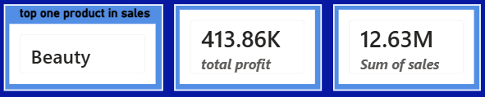
DATA ANALYSIS
key metrics
total sales : 12.63M
total profit : 413.86K
average quantity sold : 3.00/5 ( star rating )

Slide 5
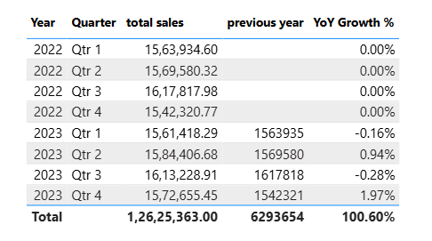
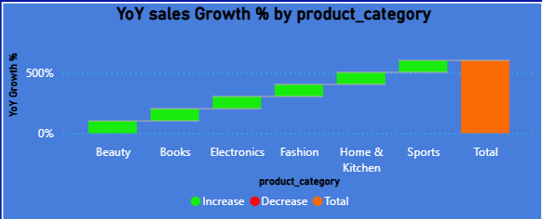
YEAR OVER YEAR GROWTH ON ORDER DATE ( YEAR, QTR, MONTH,DAY)
YOY GROWTH ANALYSIS
product category growth is increase
0.60% in 2022 – 2023.
product growth is decrease in 2023
Qtr1, Qtr3 .

Slide 6
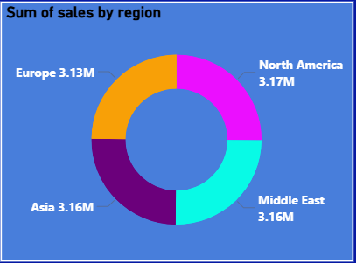
REGIONAL WISE SALES
DATA PIONTS :
North America : 3.17M { Top sales }
Middle East : 3.16M
Asia : 3.16M
Europe : 3.13M { low sales }.
Regional sales is incredibly balanced globally, with less than 2% variance between the top & low regions.

Slide 7
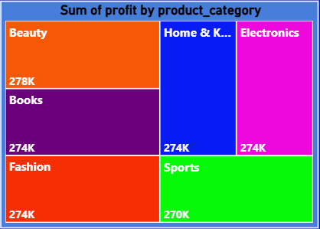
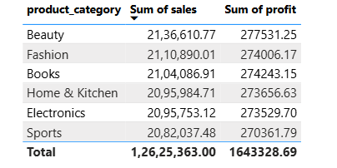
Product category performance
Visual: “sum of profit by product category “ Treemap .
rankings:
beauty : Top in profit and sales .
sports : low in profit .

Slide 8
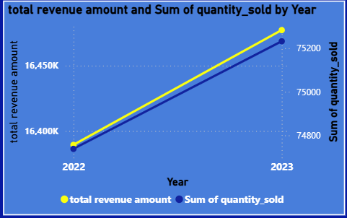
Growth 2022 - 2023
visual: Total revenue amount and sum of quantity sold by year .
both revenue and quantity sold show a
upward trend from 2022 – 2023.
Revenue increase from 16.3K to 16.4K.
quantity increase from 74 K to 75 K.

Slide 9
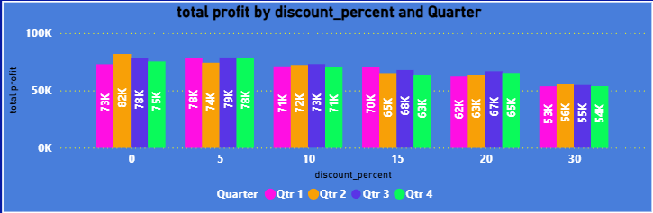
The impact of discounting on profit
visual : “Total profit by discount percent and quarter” Bar chart.
Observation :
peak profit occurs at the 5% discount level.
The profitability drop significantly once discounts hit 30%.

Slide 10
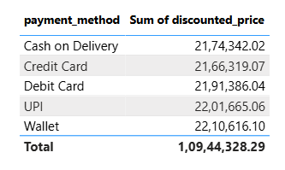
Payment methods
visual: “sum of discount price by payment method “ table.
Findings :
cash on delivery : 2.17
wallet : 2.21
UPI : 2.20
credit card : 2.16
debit card : 2.19 .
insight: digital payments ( wallet/UPI) are the preferred methods.

Slide 11
Conclusion
Recommendations :
Regional focus : target Europe for a profitability boost to match the middle east’s performance.
Category focus : In products beauty (102.19%) and electronics(101.24%) as they are the primary engines for growth.
Discount : limit 30% discounts as they yield the lowest profit returns.

